Slide 1

Linear Algebra for Machine Learning: Data Representation
Mina Farmanbar
Associate Professor, University of Stavanger
for engineers

Slide 2
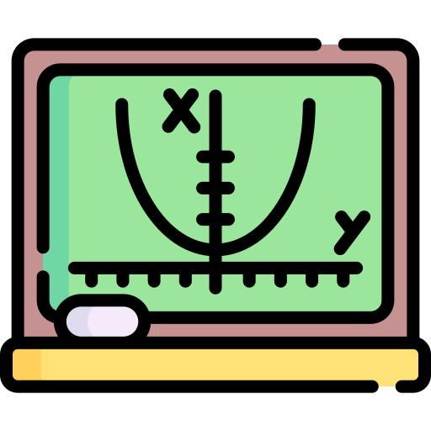
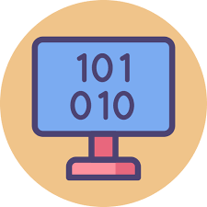


Data Representation
Linear Algebra
Data Representation
Vector Embedding
Dimensionality Reduction

Slide 3

Data Representation
AI generated, DALLE 2, 2024
How can we represent data like (images, text, user preferences, etc.) in a way that computers can understand?
Well, computers understand numbers really well!!!
Idea:
One simply organize information into a vector.

Slide 4
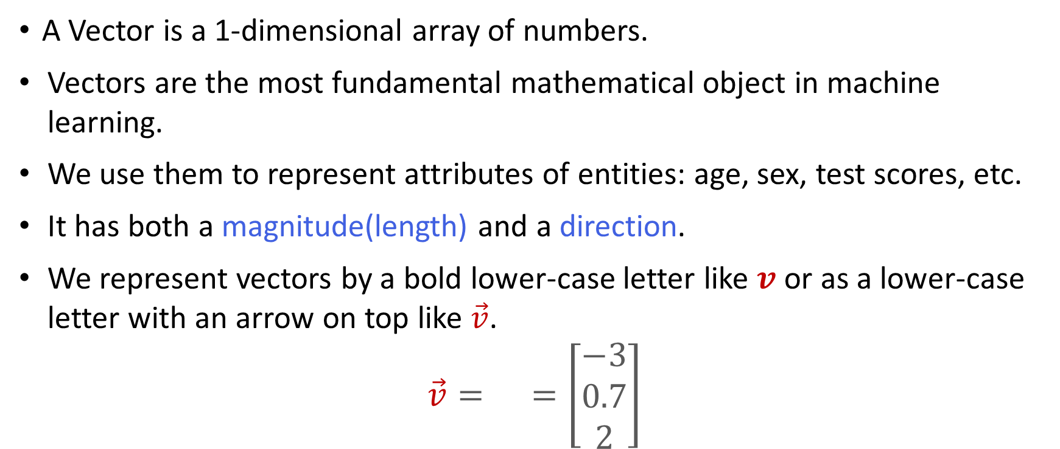
Vector
A Vector is a 1-dimensional array of numbers.
Vectors are the most fundamental mathematical object in machine learning.
We use them to represent attributes of entities: age, sex, test scores, etc.
It has both a magnitude(length) and a direction.
We represent vectors by a bold lower-case letter like $v$ or as a lower-case letter with an arrow on top like $\vec{v}$.
$$\vec{v}= =\left[\begin{matrix}−3 \\ 0.7 \\ 2\end{matrix}\right]$$

Slide 5


Vector
Another terminology you'll hear is a term called a vector space.
The totality of all vectors, with n entries is an n-dimensional vector space.
e.g. we have three numbers, so there will be three entries in a vector, this is called a three-dimensional vector space.
$$R^{3}$$
$$\left[\begin{aligned}∗ \\ \begin{aligned}∗ \\ ∗\end{aligned}\end{aligned}\right]$$

Slide 6
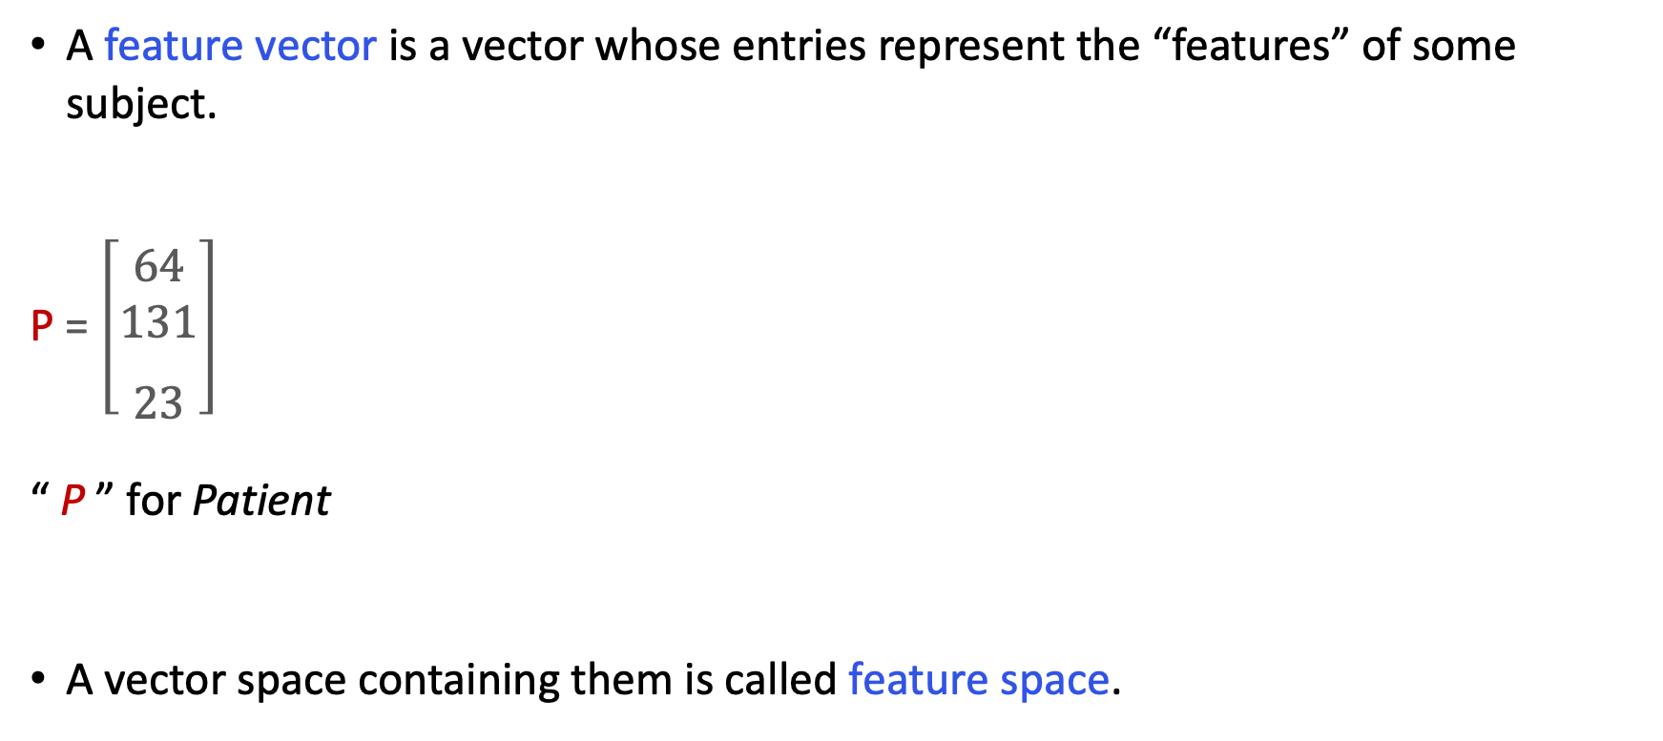
In context of machine learning
A feature vector is a vector whose entries represent the “features” of some subject.
P = $\left[\begin{matrix} \\ \begin{aligned}64 \\ 131\end{aligned} \\ \\ 23\end{matrix}\right]$
“ P ” for Patient
A vector space containing them is called feature space.
age
height
weight
age
weight
height

Slide 7
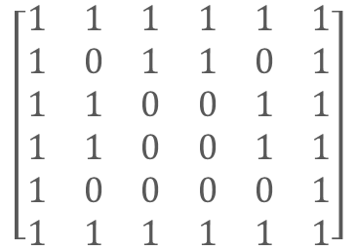

Examples of data representations: Images
In black and white images, black and white pixels corresponds to 0s and 1s.
Grayscale pixels are numbers between 0 and 255.
Both assemble into a 1-dimensional array of numbers.
$$\left[\begin{aligned}1 \\ 1 \\ 1 \\ 1 \\ 1 \\ 1 \\ 1 \\ 0 \\ 1 \\ 1 \\ 0 \\ . \\ . \\ .\end{aligned}\right]$$
$$\left[\begin{matrix}1 & 1 & 1 & 1 & 1 & 1 \\ 1 & 0 & 1 & 1 & 0 & 1 \\ 1 & 1 & 0 & 0 & 1 & 1 \\ 1 & 1 & 0 & 0 & 1 & 1 \\ 1 & 0 & 0 & 0 & 0 & 1 \\ 1 & 1 & 1 & 1 & 1 & 1\end{matrix}\right]$$

Slide 8

Exmplaes of data representations: Words and Documents
Given a collection of documents (e.g. Wikipedia articles), assign to every word a vector, whose i^{th} entry is the number of times the word appears in the i^{th} document.
$$\left[\begin{matrix}\begin{aligned}0 \\ 7\end{aligned} \\ 0 \\ 0 \\ 51 \\ . \\ \begin{aligned}. \\ .\end{aligned} \\ 0\end{matrix}\right]$$
Wiki #1 Wiki #2 Wiki #3 Wiki #4 Wiki #5 . .
.
Wiki #54,000,000
Dog =

Slide 9


Examples of data representations: Yes/No or Rating
Given users and items (e.g. movies), vectors can indicate if a user has interacted with the item (1 = yes, 0 = no) or the users' ratings, say a number between 0 and 5.
$$\left[\begin{matrix}1 \\ 0 \\ 0 \\ 1 \\ \begin{aligned}. \\ . \\ .\end{aligned} \\ \\ \begin{aligned}1 \\ 0\end{aligned}\end{matrix}\right]$$
Yes No No Yes . . . Yes No
$$\left[\begin{matrix}0 \\ 5 \\ \begin{aligned}0 \\ 3\end{aligned} \\ \\ \begin{aligned}. \\ . \\ .\end{aligned} \\ \\ 0 \\ 2\end{matrix}\right]$$
? Love ? Like . .
.
? Dislike
User 1 =
OR
User 4 =

Slide 10
Non-numerical data
What about non-numerical data,
such as language?

Slide 11
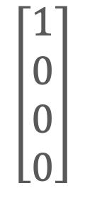


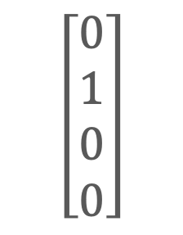
Example of data representations: “One-Hot Encodings”
Assign to each word a vector with one 1 and 0s elsewhere. This is called a one-hot encoding (or a “standard basis vector”). For example, suppose our language only has four words:
$$\left[\begin{matrix}1 \\ 0 \\ 0 \\ 0\end{matrix}\right]$$
$$\left[\begin{matrix}0 \\ 1 \\ 0 \\ 0\end{matrix}\right]$$
$$\left[\begin{matrix}0 \\ 0 \\ \begin{aligned}1 \\ 0\end{aligned} \\ \end{matrix}\right]$$
$$\left[\begin{matrix}0 \\ 0 \\ 0 \\ 1\end{matrix}\right]$$
Apple =
Cat =
House =
Tiger =
Now imagine having tens of thousands of words…

Slide 12
Some drawbacks to consider:
These vectors can be very sparse
A sparse vector is one with lots of zeros
500,000 users and 1,000,000 movies
Possible lack of meaningful relationships between vectors
One-hot encoding are never “similar”
Similarity is measured by the dot product

Slide 13

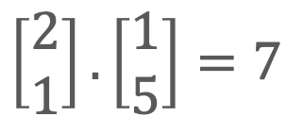
The dot product
Just like we can multiply numbers, we can also multiply vectors.
This is called the dot product.
The dot product of numbers is another number.
While the dot product of vectors is not another vector
$$\left[\begin{matrix}2 \\ 1\end{matrix}\right].\left[\begin{matrix}1 \\ 5\end{matrix}\right]=7$$
$$2×5=10$$
vs
A number
Numbers
Vectors

Slide 14

The dot product
$$\left[\begin{matrix}1 \\ 0 \\ 3\end{matrix}\right]⋅\left[\begin{matrix}7 \\ 2 \\ −1\end{matrix}\right]=\left(1\right)\left(7\right)+\left(0\right)\left(2\right)+\left(3\right)\left(−1\right)=4$$

Slide 15
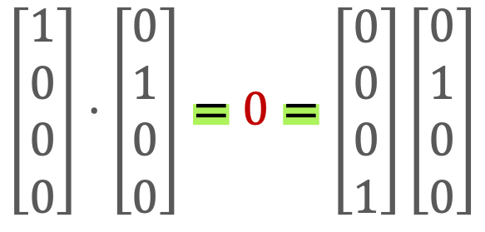
The dot product
Dot products between words are zero, no matter how “similar” they are.
$$\left[\begin{matrix}1 \\ 0 \\ 0 \\ 0\end{matrix}\right]⋅\left[\begin{matrix}0 \\ 1 \\ 0 \\ 0\end{matrix}\right]=0=\left[\begin{matrix}0 \\ 0 \\ 0 \\ 1\end{matrix}\right]\left[\begin{matrix}0 \\ 1 \\ 0 \\ 0\end{matrix}\right]$$
Apple . Cat =
= Tiger . cat

Slide 16
Solution??
Look for better vector representations
And that leads us to our next topic – namely, Vector Embeddings.

Slide 17
Thank you!
Mina Farmanbar
mina.farmanbar@uis.no

